Slide 1
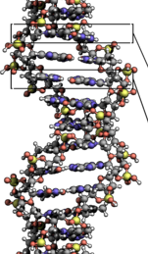
Optimal circularization length: ~400 bp (136 nm) with an integral number of turns (multiple of 10.4 bases)
395 bp ~ 38 turns
134.3 nm length
21.4 nm radius
2 nm diameter

